Slide 1
CS640 Project2
Teammate: Shifeng Li , Mingrui Yang and Anrui Wang

Slide 2
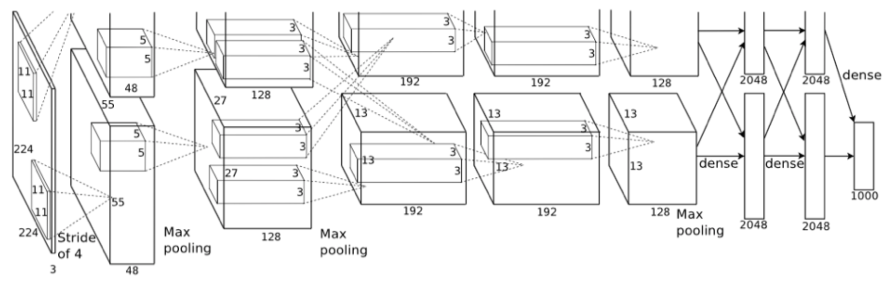
Basic theory
Convolutional Neural Networks (CNN)

Slide 3
VGG NET
Structure
The structure of
VGG contains
19 convolutional layers

Slide 4
Image pre-process
224*224 as input in vgg19
Use the function such as:
· rotate
· shift
· zoom
· shear
to get more samples.

Slide 5
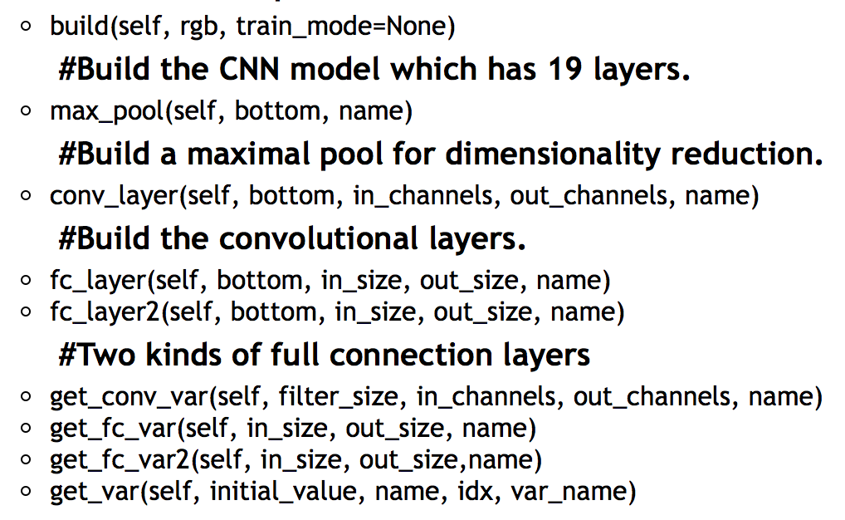
TRAINING
Function utilized for training

Slide 6
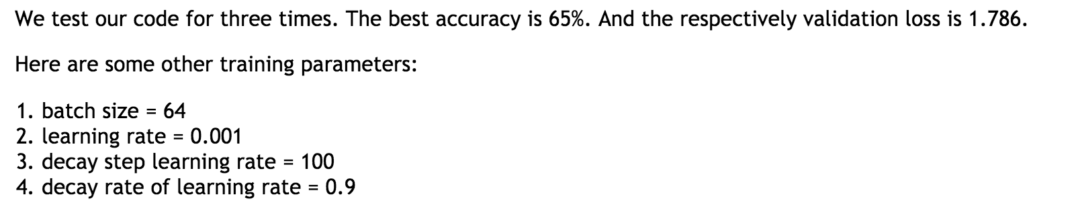
test
Using the training data for testing.

Slide 7
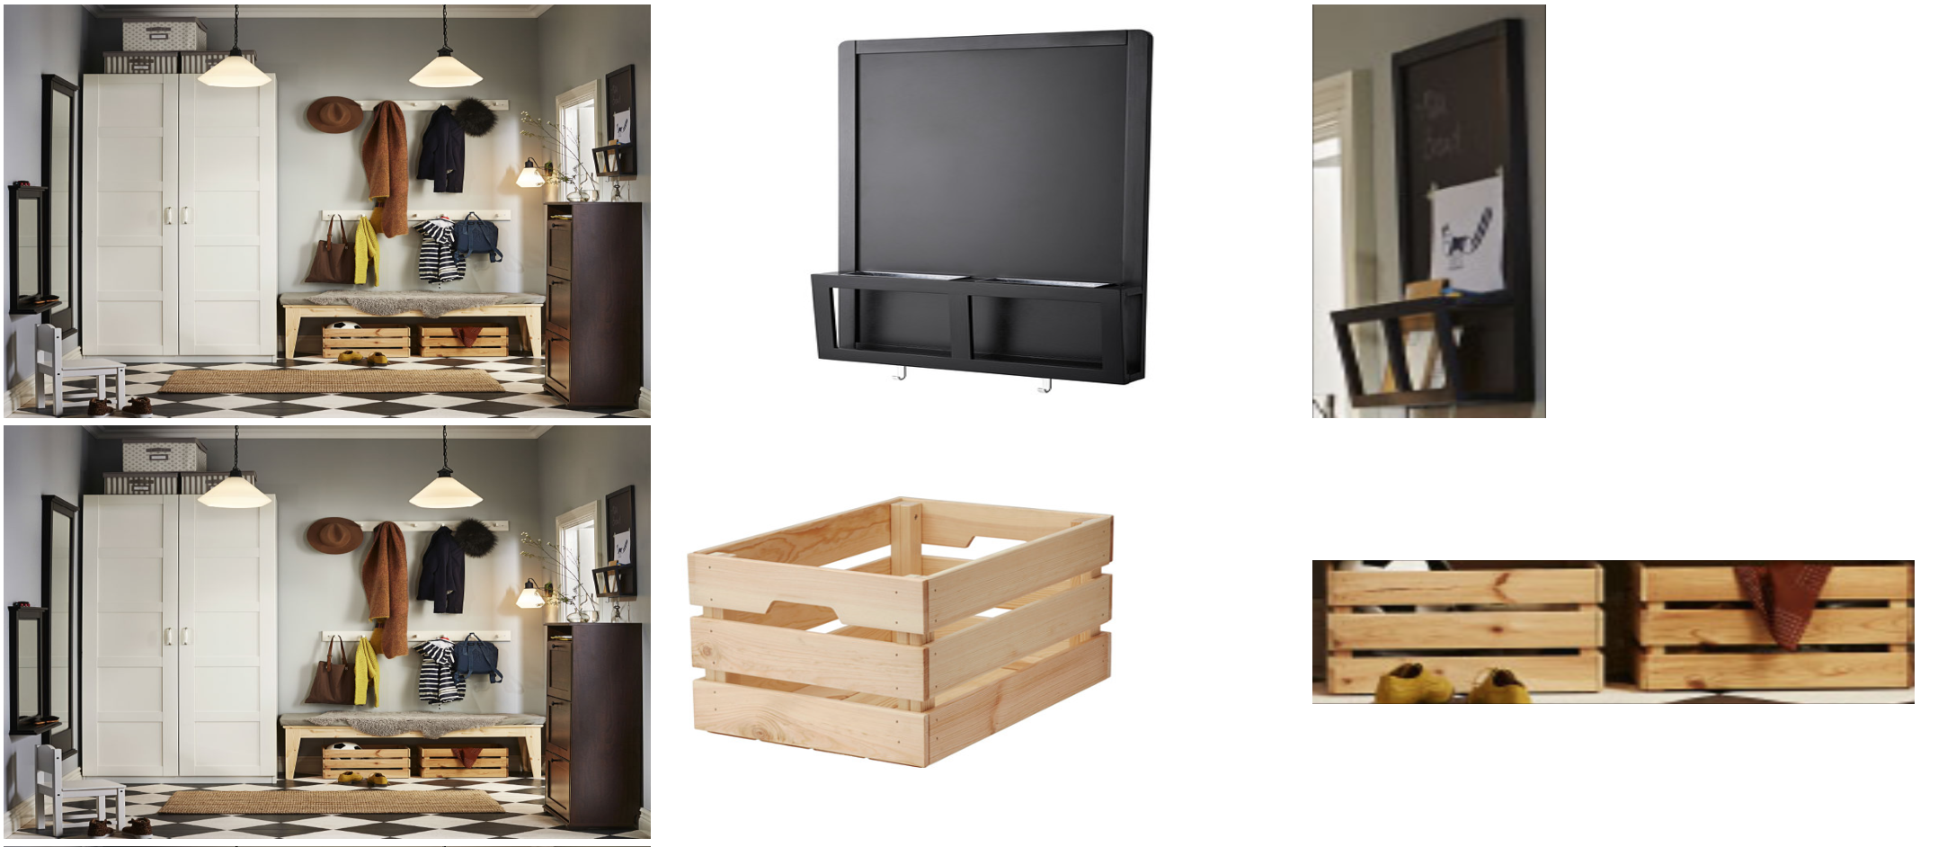
location

Slide 8
discussion
Strengths:
In our CNN model, since our filters are 3*3 size of pixels, we don't have too many parameters (weights) of filter. We also use 2*2 max pooling layer, so that the stride is 2. Moreover, the VGG model will train the data layer by layer, so we can achieve the result of every training layer.
Weaknesses:
For our model, we need relatively more time to train our data sets. We also need large number of training data to get a better result for the accuracy.

Slide 9
conclusion
We have got a barely satisfying result, because the number of the training data is not big enough while the classification is too many. Meanwhile, the version of Tensorflow is 1.4 rather than the latest one, which triggers the the unsatisfying accuracy. In the future works, we need to get more training examples to achieve a better accuracy result.

Slide 10
END

